Slide 1

Inverse Wave Equation Generative Modeling
Presentation by Akhil Sasi Kumar

Slide 2
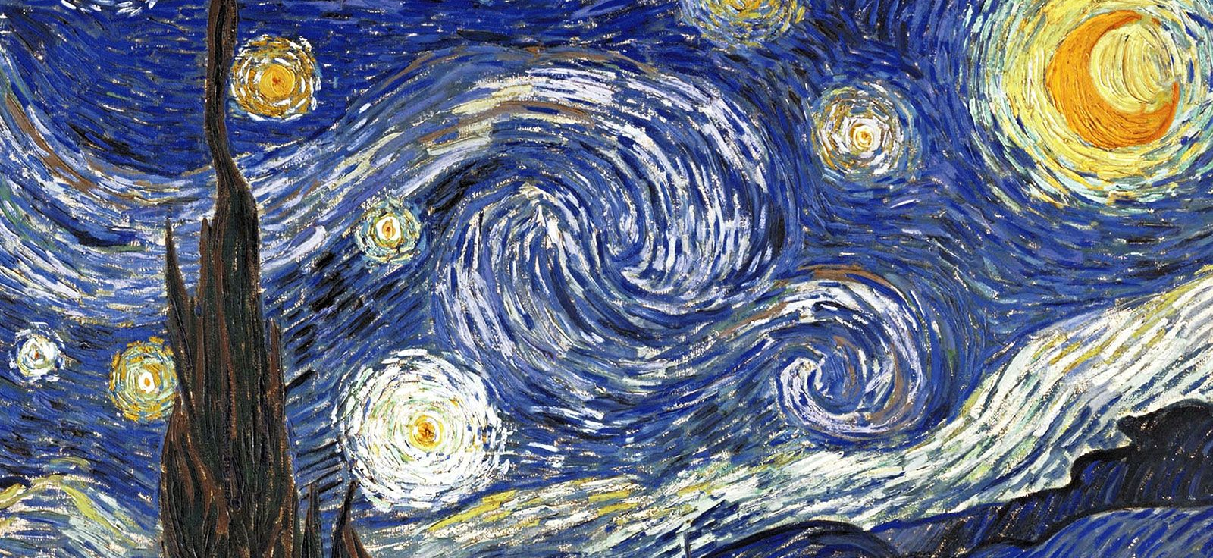
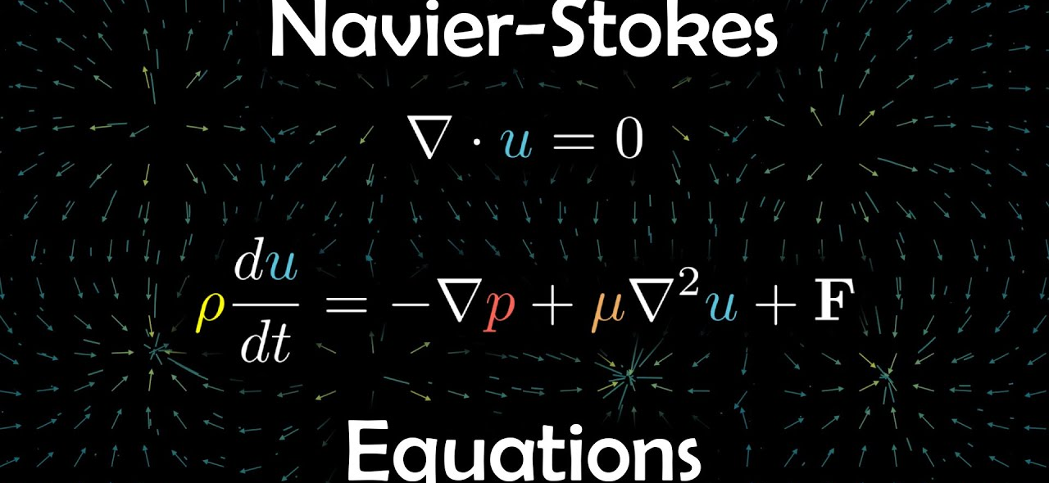
Can Physics be used for Generative modeling?
Yes, Physics itself is a generative model.
E.g., Navier-Stokes Equation describing fluid dynamics and turbulent flow.

Slide 3
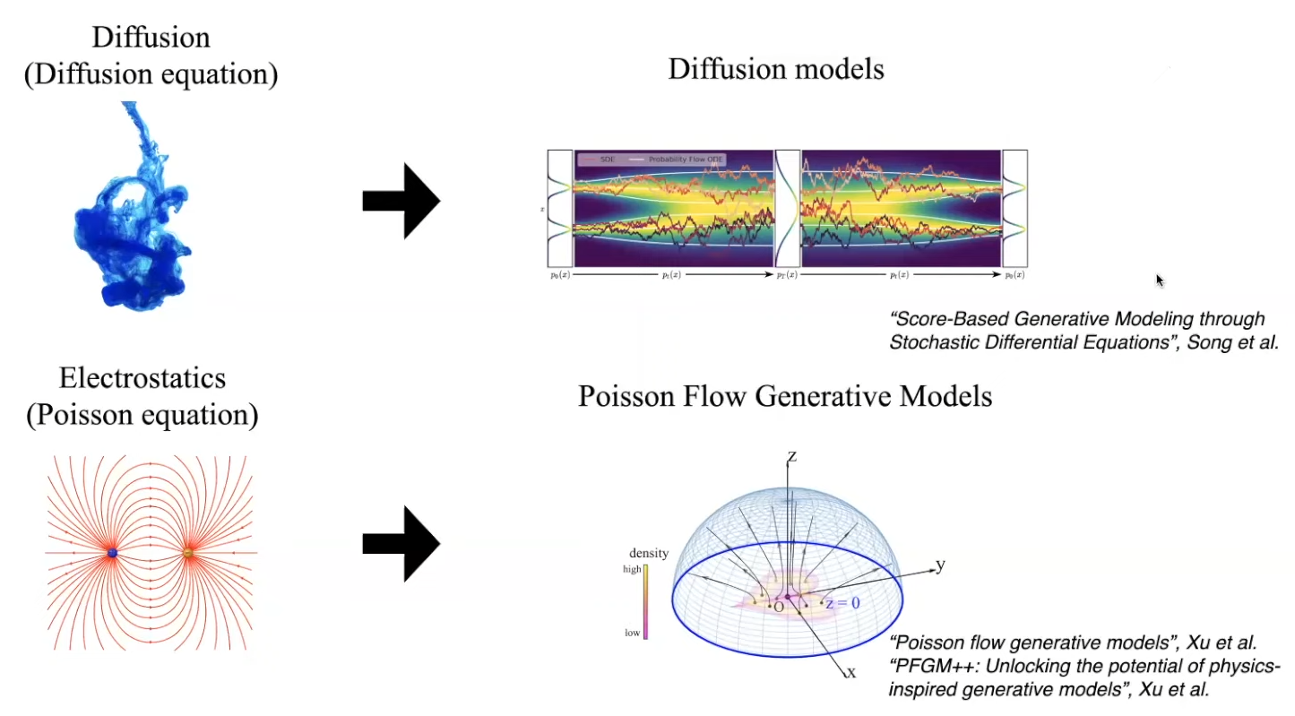
From Physics to Generative models

Slide 4
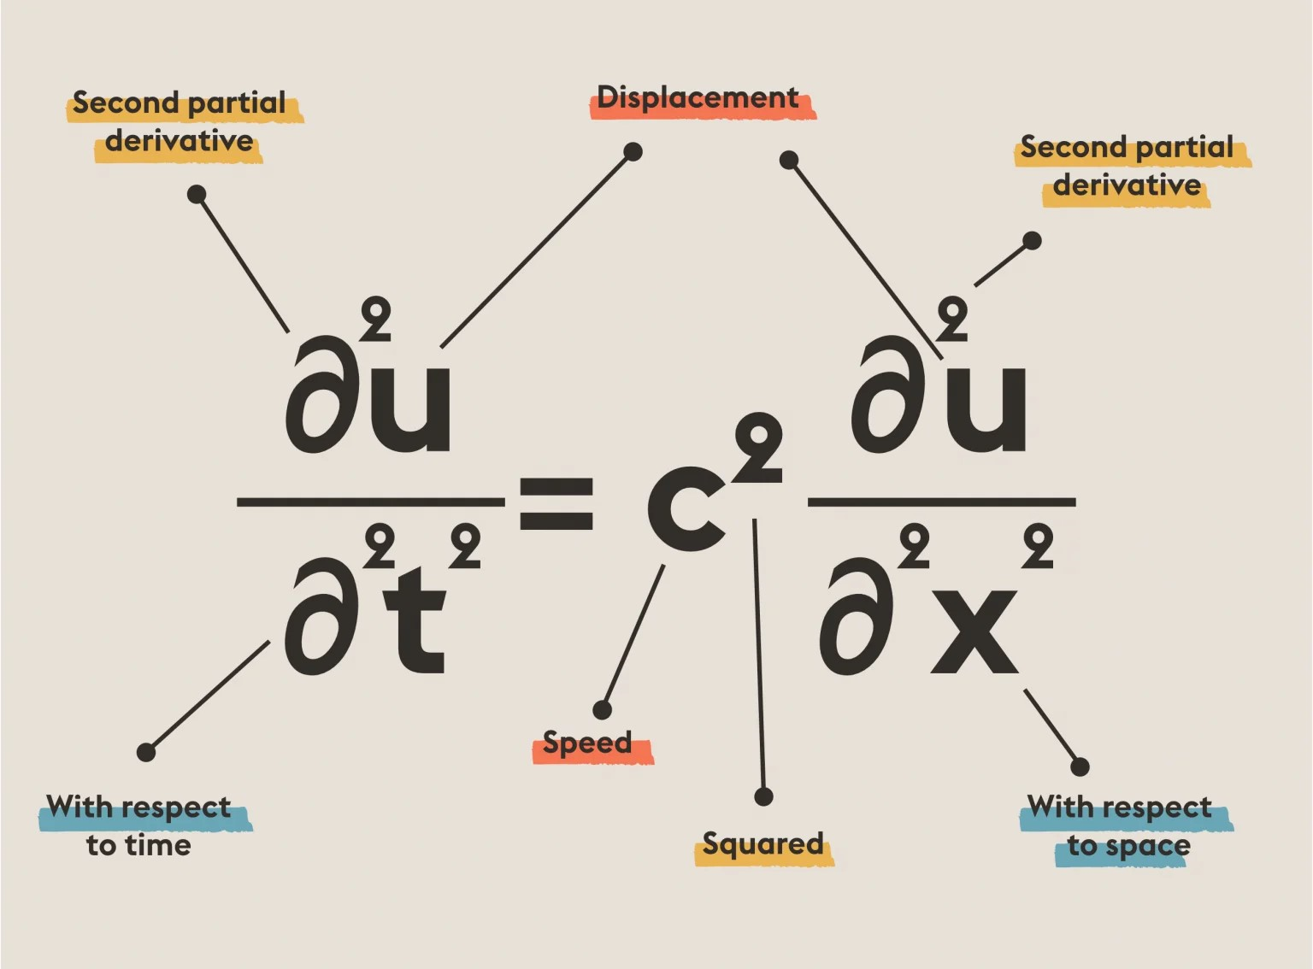
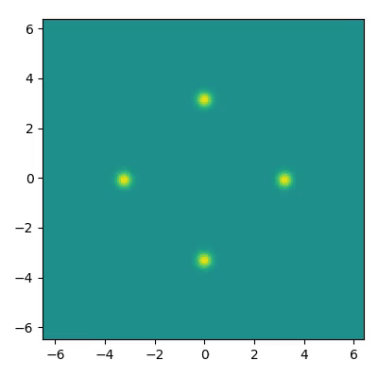
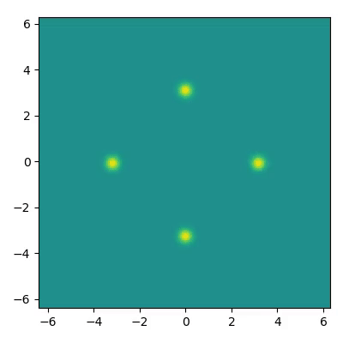

Wave Propagation and Wave Equation
wave propagation in a homogeneous isotropic medium with periodic boundary conditions.
No dispersion, No dissipation
0.05 dispersion, No dissipation
0.05 dispersion, 0.04 dissipation

Slide 5
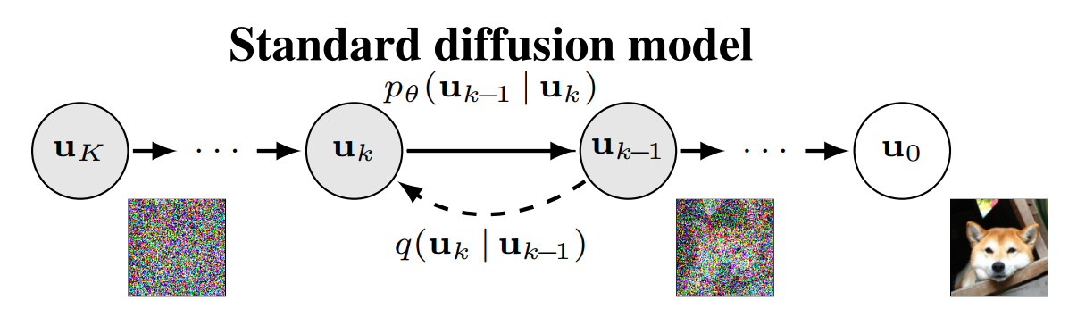
Research Proposal

Slide 6
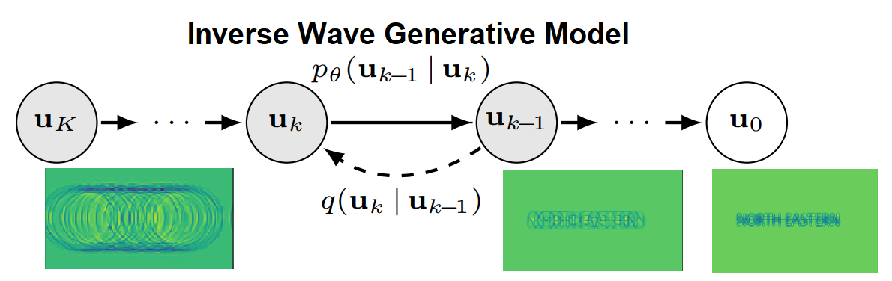

Research Proposal

Slide 7
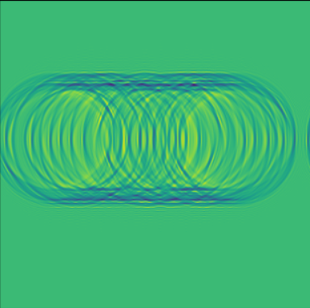
Challenges
Sampling from the model: The evolution of waves towards a prior distribution which must be well defined for sampling.
Investigating the effectiveness of this approach: With this I can focus the project towards ICLR 2024(July) or ICML 2024(May).
Prior Distribution right now looks like

Slide 8
Reference
Inverse Heat Equation (https://arxiv.org/pdf/2206.13397.pdf)
Simulating wave propagation with the optical Fourier engine (https://medium.com/optalysys/simulating-wave-propagation-with-the-optical-fourier-engine-f4a9f2e74d28)
GENPHYS: From Physical Processes to Generative Models (https://arxiv.org/pdf/2304.02637.pdf)

